Slide 1
LICENSE PLATE RECOGNITION SYSTEM
Revolutionizing Automated
Vehicle Identification

Slide 2
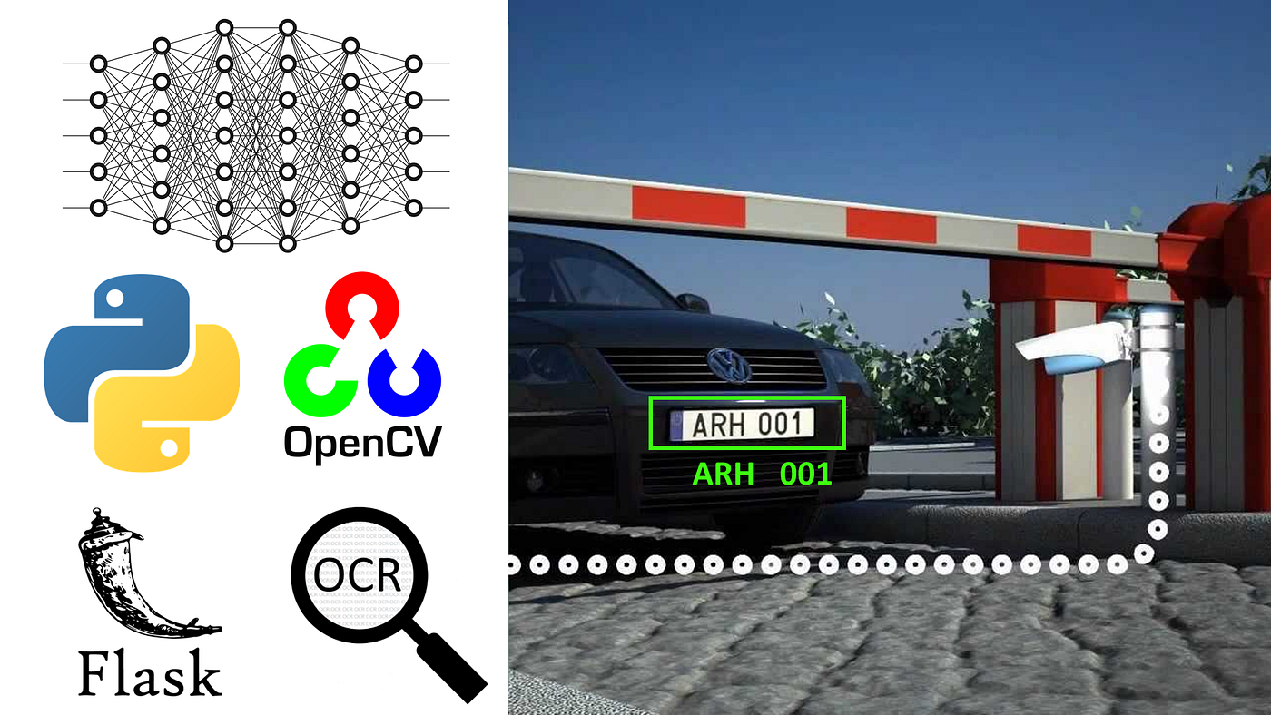
INTRODUCTION
License Plate Recognition (LPR) is a technology that uses cameras and software to identify and extract license plate information from vehicles automatically. It plays a crucial role in applications such as traffic monitoring, toll collection, parking management, and law enforcement.
The system combines computer vision, artificial intelligence, and optical character recognition (OCR) to process images and recognize text.

Slide 3
LPR
WORKFLOW

Slide 4
STEP 1
INPUT
Tesseract accepts images in common formats like PNG, JPEG, and TIFF.
It works best with grayscale or black-and-white images, but it can handle color images as well.

Slide 5
STEP 2
PREPROCESSING
Image conversion to grayscale and binary black and white
Thresholding of pixels using OTSU method.
Noise Removal
Skew Detection and correction

Slide 6
STEP 3
SEGMENTATION
Divides the image into text and non text regions
Segment text lines into individual words
Group connected components horizontally

Slide 7
STEP 4
FEATURE EXTRACTION
Measures width of strokes to identify key patterns
Uses LSTM for sequential recognition of text from image
Converts segmented text lines into a sequence of feature vectors

Slide 8
STEP 5
POST PROCESSING
Uses an n-gram model to predict the most likely word sequence
Compare the words against a predefined dictionary
Flags and corrects misspelled words

Slide 9
KEY TECHNOLOGIES
COMPUTER VISION
Computer vision techniques used to detect license plate region in image
Analyse frames through pixel threshold,color or patterns
MACHINE LEARNING
Machine learning especially neural networks like RNN enhances the ability to detect plates
Training data includes thousands of license plate images with variations in font, sizes etc.
OCR
OCR technology converts images of license plate into machine – readable text form
Pre-Trained models like Tesseract OCR can be customized for license plate formats
HARDWARE
High- resolution cameras are essential for capturing clear images of vehicles and plates
Sensors can be used to trigger cameras ensuring images are captured when there is vehicle

Slide 10
4
5
1
2
3
ACCESS CONTROL
LOGISTICS
TRAFFIC LAW ENFORCEMENT
TOLL COLLECTION
PARKING MANAGEMENT
APPLICATIONS OF LPR
Detecting violations like speeding and running red lights
Automating toll collection by recognizing number plates
Restricting the access of public vehicles to secure areas
Tracking of commercial vehicles for logistics
Managing vehicle entry and exit in parking lots

Slide 11
1
2
3
4
5
TRAFFIC LAW ENFORCEMENT
TOLL COLLECTION
PARKING MANAGEMENT
ACCESS CONTROL
LOGISTICS
APPLICATIONS OF LPR
Detecting violations like speeding and running red lights
Automating toll collection by recognizing number plates
Managing vehicle entry and exit in parking lots
Restricting the access of public vehicles to secure areas
Tracking of commercial vehicles for logistics

Slide 12

PRO’S
Automation:
Reduces manual labor for tasks like toll collection and parking management.
High Accuracy:
Advanced LPR systems achieve up to 98% accuracy under optimal conditions.
Real-Time Processing:
Quickly identifies vehicles, enabling immediate responses in traffic enforcement or security applications.
Enhanced Security:
Monitors and records vehicle movement in sensitive areas like borders, airports, and secure facilities.
Cost-Effective (Long-Term):
Reduces dependency on human operators, leading to long-term savings.

Slide 13

CONS
1. Environmental Limitations:
Performance is affected by poor lighting, adverse weather, or extreme conditions.
2. Plate Variability:
Challenges arise due to different fonts, languages, damaged plates, or non-standard designs.
3. High Initial Costs:
Requires significant investment in high-quality hardware and advanced software.
4 .Privacy Concerns:
Raises issues about the collection and storage of personal data, leading to regulatory challenges.
5. Maintenance Needs:
Regular updates, calibration, and hardware servicing are required for optimal performance.

Slide 14
THANK YOU

